Slide 1
Bank Management System

Slide 2

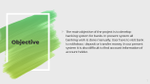

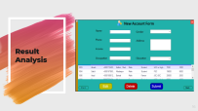

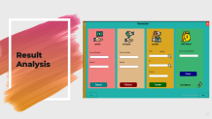

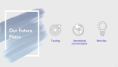
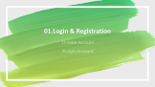

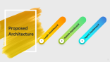
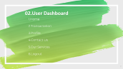




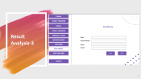

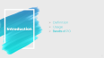
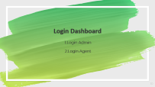
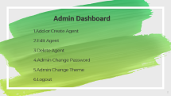
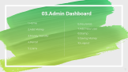
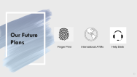
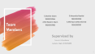

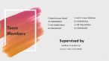
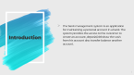

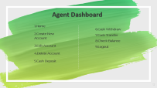
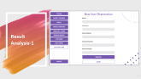
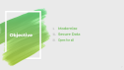
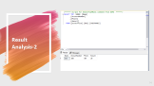

Slide 3
Team Members
1. Akash Kumar Nondi
ID: 19202103325
2. Md. Shafiul Alam
ID: 19202103327
3. A.N.M. Liazur Rahman
ID: 19202103344
4. Md. Raju Raihan
ID: 19202103351
Supervised by
Badhan Chandra Das
Lecturer , Dept. of CSE (BUBT)

Slide 4


Outline of This Presentation!
Introduction
Related Works
Proposed Architecture
Result Analysis
Conclusion
Future Plans

Slide 5
Introduction
The bank management system is an application for maintaining a personal account in a bank. The system provides the access to the customer to create an account ,deposit/withdraw the cash from his account also transfer balance another account.

Slide 6
Problem Definition
Paper wastage can be reduced.
Easiest way for creating an account .
Easiest way to deposit and withdraw money without any risk.
Check balance without any hassle.
Easiest way to transfer money.

Slide 7
Objective
The main objective of the project is to develop banking system for banks. In present system all banking work is done manually. User have to visit bank to withdraw, deposit or transfer money. In our present system it is also difficult to find account information of account holder.

Slide 8



RELATED WORKS
Rocket
Nagad
BKash
.

Slide 9
Proposed Architecture
Login Dashboard
Admin Dashboard
Agent Dashboard
1
2
3

Slide 10
Login Dashboard
1.Login Admin
2.Login Agent

Slide 11
Admin Dashboard
1.Add or Create Agent
2.Edit Agent
3.Delete Agent
4.Admin Change Password
5.Admin Change Theme
6.Logout

Slide 12
Agent Dashboard
1.Home
2.Create New Account
3.Edit Account
4.Delete Account
5.Cash Deposit
6.Cash Withdraw
7.Cash Transfer
8.Check Balance
9.Logout

Slide 13
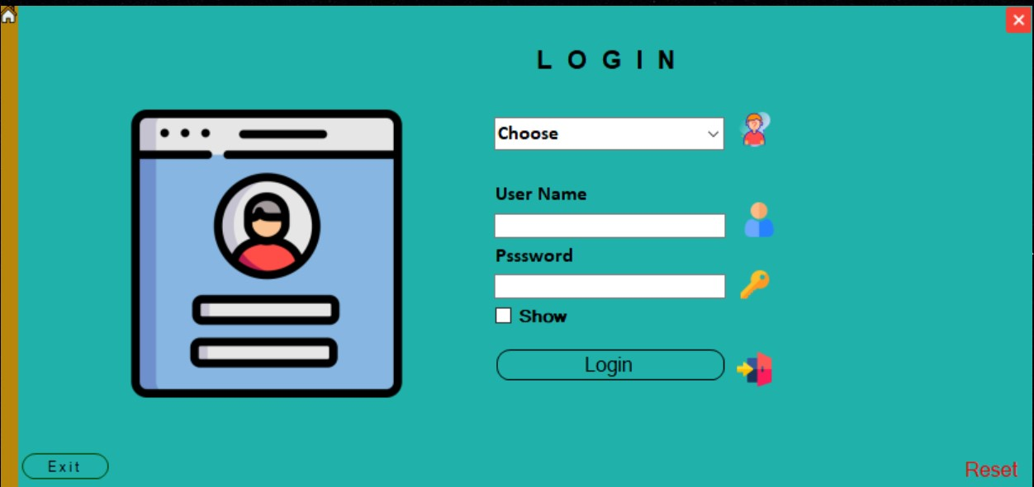
Result Analysis

Slide 14
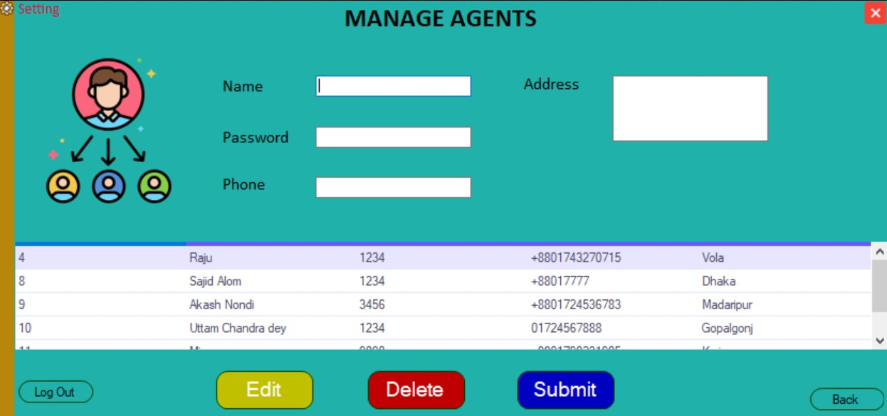
Result Analysis

Slide 15
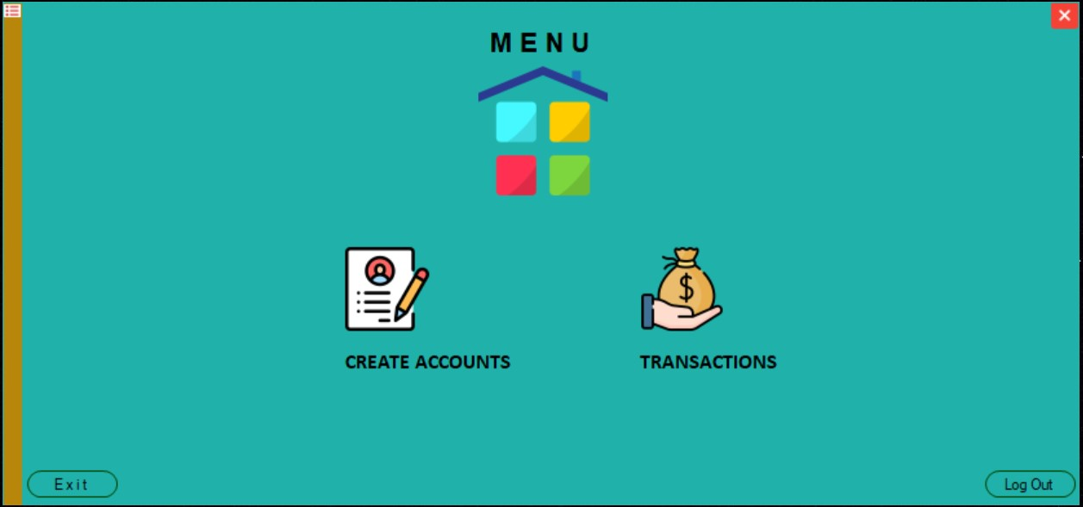
Result Analysis

Slide 16
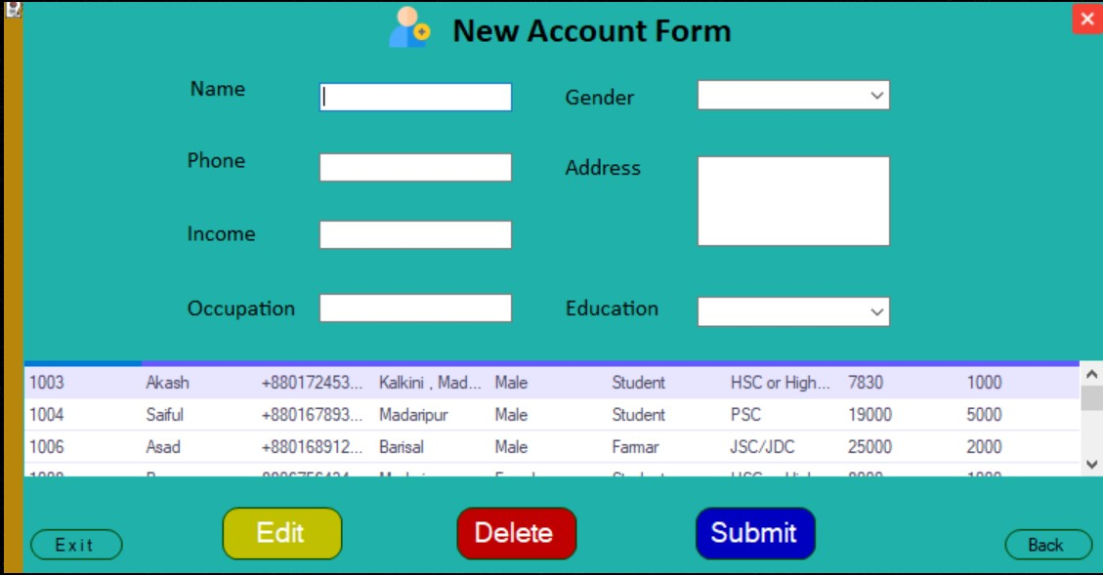
Result Analysis

Slide 17
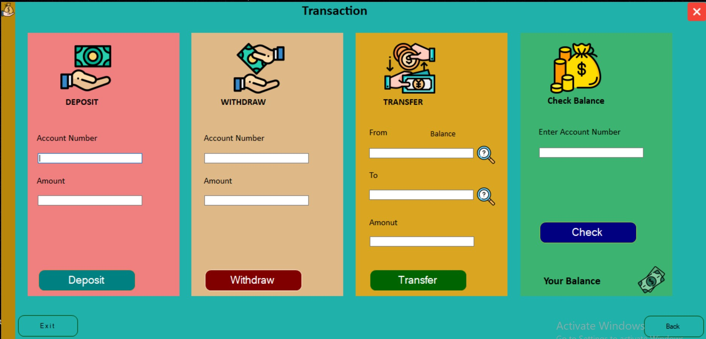
Result Analysis

Slide 18
Conclusion
This Banking System will serve as useful approach to deposit , withdraw and transfer the money for the person. It reduces the time taken by the user to save money .Bank management system developed is user friendly .It reduces manual work.

Slide 19



Our Future Plans
Finger Print
International ATMs
Help Desk

Slide 20
THANK YOU!
Any questions?

